Slide 1
Promotion Examination for NAHCON Staff of ICT Department
Lukman Lamid I
.
By Hajj Institute of Nigeria
March 2024

Slide 2
Meet the Instructor
System Analyst and SA Tech to DG NITDA
B.Sc, Computer Science
M.Sc, Business IT (e-Government Major)
Certified Digital Business Transformation Practitioner (CDTP)
Business Transformation Management Methodology-BTM2 (Certified)
MIT Certificate in Digital Transformation: Platform Strategies for Success
Lead Implementer: ISO 9001:2015 (QMS Certified)
PECB GDPR Certified Data Protection Officer

Slide 3
Intro: NAHCON & ICT/IT

Slide 4
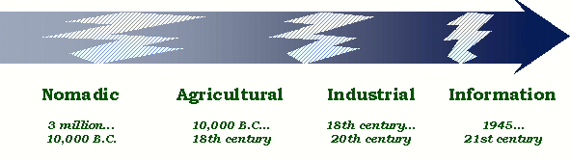
Why Computer and Information Technology?
IT/ICT
=
Data
Information
Knowledge
+
Technology
IT/ICT
Software/Application
Hardware
Services
The Global Challenges at the Industrial and Post industrial Era?
Notes:
The Global Challenges at the Industrial and Post industrial Era? The need to collect, store, process, transmit, communicate and transform data in LARGE QUANTITY into Information or knowledge; and
Businesses sprang up and every business is an information business including Governance or government businesses. (Products and Services)
Data is a random collection of facts and figures.
Information is the processed form of data which is meaningful to recipient for decision making now or in future
Anything that makes things/jobs easier. E.g. tools, techniques/machine.
Technology is the use of machines/tools/techniques to perform jobs more easily and fast. Technology is dynamic.
IT is synonymous to the use of computers to transform data into information
IT makes it easier and cheaper to work for oneself. Those who seek out new information constantly are the ones who succeed in today’s workplace.
The need to manage business effectively

Slide 5
NAHCON Business and IT

Slide 6
NAHCON and ICT
NAHCON ICT Department’s overall goal is to work in partnership with other departments to deliver an integrated, efficient, and secure working environment where information is readily available to help regulate and coordinate the affairs of Hajj and Umrah;
The role of ICT Officer offers a fantastic opportunity to contribute to this goal and make a positive impact by supporting the use of technology in NAHCON; and
Enabling the delivery of effective and secure IT systems, and services and contributing to effective management and operations of Hajj and Umurah.

Slide 7
NAHCON Business and IT in Details

Slide 8
Job Description of ICT officer
ICT Policy & Strategy
ICT Frameworks and Standard
System Analysis and Design
System Development, testing and Deployment
System Administration
Network Management
User Support
Data Management
ICT Compliance
Project Management

Slide 9
Digital As The New Trend

Slide 10
Digital
Digital is the convergence of multiple technological innovations enabled by connectivity.
Fundamentally, it is all about using data to make better and faster decisions, and develop much more iterative and rapid ways of doing things;
Digital requires being open to re-examining your entire way of doing business (Governance & Service Delivery) and understanding where the new frontiers of value are.
Notes:
Definition by: International Institute for Management Development (IMD) and Global Centre for Digital Business Transformation

Slide 11
Digitization, Digitalization and Automation
Digitization
Digitalization
Automation
Digitisation
The conversion of analog information into digital representation such as texts, photographs, and voices, among others to be used by computer systems for automated processes or workflows.
Digitalisation
It is the innovative ways/processes of leveraging digitisation to improve business.
The use of digital technologies and data to change and evolve business models
Automation
The creation and application of technology to monitor and control the production and delivery of products and services without periodic human assistance. It is based on data and data analysis. It is one of the ways digitalization can be implemented and put the new business models into action.
Notes:
What have you digitised in your office: Record, files, business processes of delivering services?
Examples of Digitisation:
Scanning a paper document and saving it on computer's hard drive as a digital document, like PDF.
Going from notes on paper to typing them up in an Excel spreadsheet.
Converting from analog VHS cassettes to CD, DVD or Blu-Ray discs containing digital data.
Example of Digitalisation:
Saving customer information on a database instead of saving it in hard copies and spread sheet. Once you do it you have a lot of data on your hand. Digitalization would be the process of using that data to analyze your clients' behaviors.
Automation Example:
Restaurant example:
Collecting orders using a tablet or a mobile phone (instead of a waiter)
Sending orders to the kitchen through a computer (instead of writing them down and passing them)
Starting the oven at 8:30 AM by a timer (instead of making a cook start it)
Bringing the meals to the customers using a robot
Online Resources:
https://www.netguru.com/blog/digitization-and-digitalization;
https://www.quora.com/What-is-the-difference-between-digitalization-and-automation

Slide 12
Digital Technologies
Digital technologies: Electronic tools, systems, devices and resources that generate, store or process data.
Examples: Software, Hardware, Computer/Mobile Phones/Smart Phones, Web and Mobile technologies, Telecommunications/Digital Telecommunication, Social media, Multimedia, Cloud Computing, IoT, Blockchain, Big Data, Artificial Intelligence/Machine Learning, Biochips, Quantum Computing, Facial Recognition, Natural Language, 5G, 3D Printing, Predictive Analytics, Virtual/Augmented Reality etc.
Notes:
https://www.raconteur.net/digital-transformation/top-10-digital-tech-the-boss-should-know-about
https://www.encyclopedia.com/history/dictionaries-thesauruses-pictures-and-press-releases/digital-technology

Slide 13
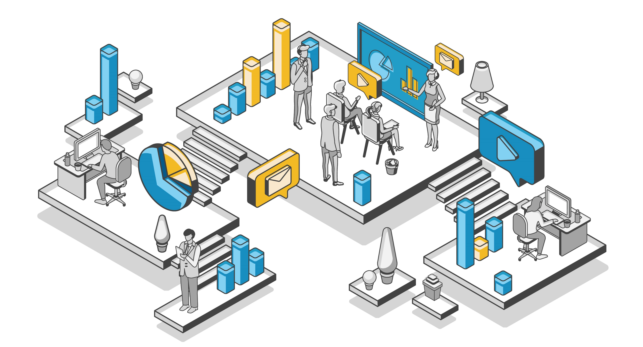
Digital Business Transformation
Is an organizational change through the use of digital technologies, business models and innovations to improve performance
Is a holistic change of business processes, structure, people, culture, products, business models and other activities by an organisation to fully leverage the opportunities of digital technologies, innovations and digital economy to improve its performance.
The world as we know it is continually changing, and one of the fundamental drivers of change is digital transformation.

Slide 14
Imagine Where NAHCON Is

Slide 15
Digital Service & Transformation Stages

Slide 16
Holistic View

Slide 17
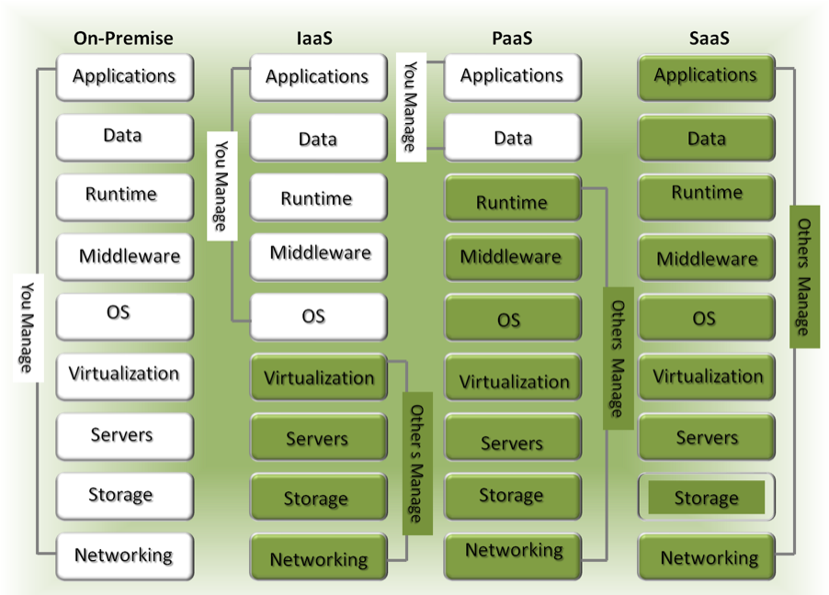
Notes:
on-demand self-provisioning

Slide 18
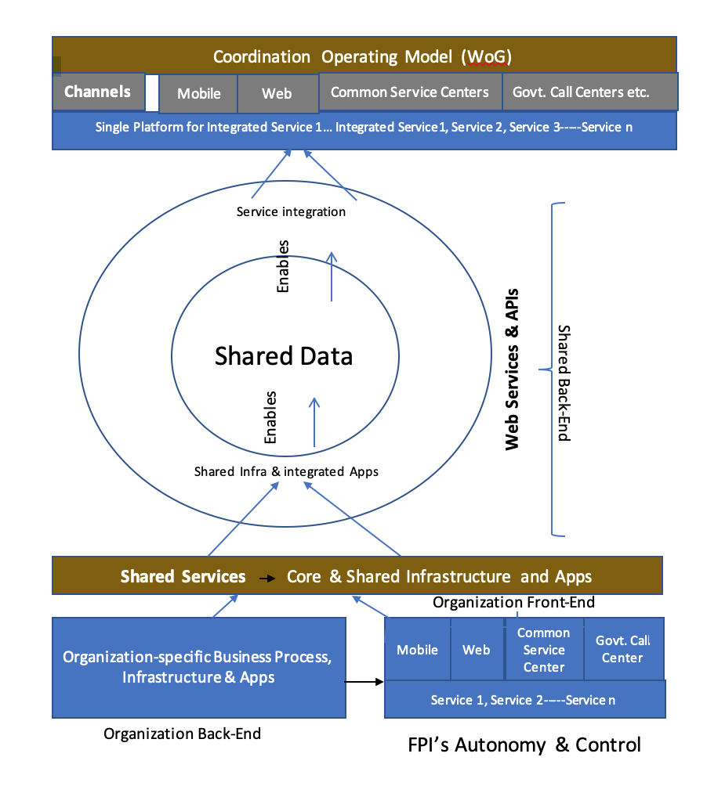

Slide 19
What to be Digitalized and Possible Digital Technologies

Slide 20
Digitalising Pilgrimage Processes
The Three Assuming Stages of Pilgrimage
Preparation for Hajj and Umrah: Planning, Licensing, Registration, Information Dissemination, Payment, Sensitisation and training, etc.
Performing the Hajj and Umrah: Identification, Accommodation, feeding, pilgrims monitoring, Information Dissemination, etc.; and
Coming Back Home: Luggage monitoring & security, information dissemination; etc.

Slide 21
Basic Technologies for Hajj and Umrah Operation
SMS
1
2
USSD
Web Tech
3
4
Mobile Tech
Social Media
5
6
QR Code
Productivity tools
7
Notes:
,

Slide 22
Emerging Technologies for Hajj and Umrah Operation
IoT (Sensor, RFID,
Wearables, Drone)
1
2
GIS (GPS, MAP, spatial Analysis)
ARTIFICIAL INTELLIGENCE (AI)
3
4
Cloud
Big Data Analytics
5
6
Blockchain
Natural Language Processing
7
8
VR/AR

Slide 23
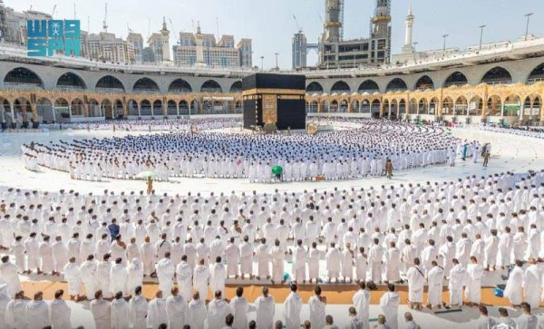
Why Digital Transformation of Hajj & Umrah?
There is an urgent need to digitally transform Hajj & Umrah because:
Customers’ expectations of Hajj and Umrah are still not met;
Hajj and Umrah processes & operations will soon be digital by the Kingdom of Saudi Arabia (KSA);
Informed and accurate decisions on Hajj and Umrah business and operations by Management are not real-time;
New and sustainable future for Hajj and Umrah has to be created and nutured
Notes:
https://enterprisersproject.com/what-is-digital-transformation
https://www.accenture.com/us-en/insights/digital-transformation-index

Slide 24
Questions ?

