Slide 1
MEMORANDUM WRITING IN THE PUBLIC SERVICE
By MUSA SALEH fwc Tel: 08033784074 Email: musasaleh1956@gmail.com

Slide 2
Learning Objectives
At the end of the presentation, participants will be able to:
discuss memorandum writing; and
highlight features of Federal Executive Council memorandum.

Slide 3
Introduction:
- A very important activity one finds himself saddled with is to produce a draft memorandum for consideration of a superior. Or in some cases preparing and submitting a council memorandum.
- The assignment would appear easy but to produce an acceptable report or memorandum requires more than just writing.
The purpose of the paper is to discuss memo writing.

Slide 4
Memorandum – a submission praying for an approval for either execution, consideration or information that may elucidate action.
There are basically two types of memorandum; Internal and External Memorandum. A typical internal memorandum looks as follows

Slide 5
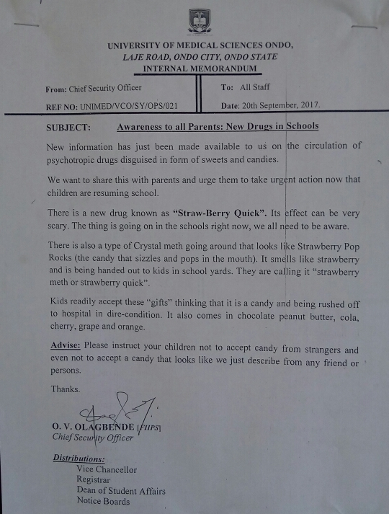

Slide 6
Council Memorandum – on the other hand a council memorandum is an external memo and is the submission by an MDA to the council through the council secretariat praying for council’s consideration of an issue.

Slide 7
Classification of Memorandum
Personal memorandum on an issue to a superior officer.
Policy making memorandum
Memorandum proposing legislation
Memorandum dealing with financial matter
Memorandum with implementation of projects in the National Development Plan
Council memorandum (Federal, State, Local Government etc.)
Memorandum on ratification of International Treaties.

Slide 8
Types of Council Papers/Board
Agenda/Notification of meeting.
Council memorandum.
Council note.
Council extract.
Council conclusion.
Annexure to memorandum.

Slide 9
Guidelines for writing memorandum
Memorandum with financial implications, economic matters, establishment matters, legislation being submitted by other ministries must be cleared with relevant ministry.
Joint memorandum could be initiated and initialled by two or three ministries.
When memo has previously been treated by council, reference of all previous decisions must be provided.

Slide 10
Draft memo when initialled by relevant minister should be placed a.b.c. Of the ministry’s subject file and minuted to the Permanent Secretary, Council Secretariat along with prescribed number of Annexes (1-100).

Slide 11
Production of Draft Memorandum - Requirements
At the top most, write – “This is the Property of Pension Transition Arrangement Directorate Board” i.e ownership
Heading – Memorandum by the Hon. Minister…. on a given Subject
Introduction
Body – Arguments, facts {short and crisp)- details in Annexes- 2-3 pages and in paragraphs
Prayers – last paragraph- could come in notes, observes, approves and direct.
Initials and Date.
Previous Reference (if any)

Slide 12
Qualities of Good Memorandum/Elements
Well defined subject with clear objective.
Presentation with relevant data and facts.
Data must be set out logically and convincingly.
Language must be simple, direct and flawless.
Input of other departments must be attached when required.
Memorandum must be concise and short.
Memorandum must be initialed by the Hon. Minister.
Memorandum so labeled becomes “top secret” document
Adhere to standard format

Slide 13
Conclusion
In conclusion, Memorandum writing is an important activity carried out in all offices. To be able to prepare good memorandum, one must have the basic knowledge of doing that.
We hope we have been able to sensitise you on how to write memoranda in an organisation.
Thank you for your attention!!!

