Slide 1
Fundamentals of Planning, Research and Statistics for NAHCON Staff

Slide 2
OUTLINE
Introduction
Planning Research and Statistics Department
NAHCON PRS
Types of Plans
Strategic Planning
Origin Of Strategic Planning
Purpose and Benefits Of Strategic Planning
Key Elements Of Strategic Planning
Process/Steps of Strategic Planning
The Research and Statistics Function
Hajj Statistics

Slide 3
Introduction

Slide 4
Islamicity Index
“I went to the West and saw Islam, but no Muslims; I got back to the East and saw Muslims, but no Islam.” (Mohammad Abduh)
Research studies are revealing that ‘Non-Muslim Countries Reflect Islamic Values Better than Muslim Countries’
The highest ranked Muslims countries (such as Malaysia, UAE and Qatar) only managed mid-table positions.
Most other Muslim countries could not even make the top-100 positions.

Slide 5
PRS In Public Service
The Department of Planning, Research and Statistics (PRS) is one of the three common service Departments established in the Federal Civil Service by Decree No. 43 of 1988. As the name implies, the Department is responsible for corporate and strategic planning, conducting research activities and keeping statistical data and information in the Federal Civil Service.

Slide 6
PRS Department In A Hajj Authority
The Planning, Research, and Statistics Department of A Hajj Authority plays a crucial role in ensuring the smooth and efficient organization of Hajj. Among its important functions are:
Strategic Planning: Develop long-term strategic plans for managing the Hajj pilgrimage.
Data Collection and Analysis: Gather and analyze data related to Hajj pilgrims, including demographics, travel patterns, accommodation needs, and health requirements. This information helps in making informed decisions and improving services.
Research and Innovation: Conduct research on various aspects of the Hajj pilgrimage; religious practices and pilgrimage logistics. Explore innovative solutions to enhance the pilgrimage experience and address emerging challenges.

Slide 7
Planning Division
Functions of NAHCON Division:
This Division prepares a road map for all operational activities of the Commission which covers short, medium and long plan
Preparation of annual calendar, quarterly and other periodic reports for the Commission
Coordinate the release of Hajj slots allocation to States
Periodic monitoring of NAHCON / States on level of implementation of calendar of event

Slide 8
Types of Organizational Planning

Slide 9
Strategic Planning
SP is a process where organisations define a bold vision and create a plan with objectives and goals to reach that future.
Where are we going?
How do we win?
Who must do what?
How do we review and adapt our strategy?
Strategy is about stretching limited resources to fit ambitious aspirations
-C.K. Prahalad

Slide 10
Strategic Planning In Islam
Islam has promoted strategic use of all resources as Allah has created all that is in the heavens, and the earth for man’s optimal use ( 2:29).
“Allah does not love those who are wasteful.” (5:64)
The Prophet (SAW) ordered the optimal use of water in ablution and the ritual bath.
He has instructed us to restrict our food consumption to one-third of our bellies and to leave the rest for water and air.
He used to plan out his battles and apply strategy for the best results …. (Al-Qur’an:2; 38;26.

Slide 11
Viewpoints On SP
We can think of strategic planning as an organization’s roadmap for success.
SP lays out a plan for moving forward, sets milestones to reach along the way, and tracks the progress of those milestones.
It is the process of giving an organization a sense of direction by analysing where they are currently and where they want to be
It is a plan of action that enhances success and growth
SP is a systematic process that helps set an ambition for an ideal future and determine how best to achieve it.

Slide 12
Origin Of SP
Dates back to ancient Greek civilization
"STRATEGY" is derived from the Greek word "STRATEGOS" meaning "General" or army leader
Modern SP has its roots from the Harvard Business School. The Harvard Policy Model was developed and taught in the early 1920s to students of the Harvard Business School.
Systematic assessment of Strengths, Weaknesses, Opportunities, and Threats or SWOT Analysis came from the Harvard Policy Model
In the late 1980s, the public sector steadily embraced SP and expressed their desire to run government more like a business..
In 2004, the Marrakech Action Plan for Statistics (MAPS) highlighted the need for African Countries to mainstream strategic planning in their statistical systems.

Slide 13
PURPOSE OF SP
Purpose is to connect three key areas:
Organisation’s vision - describing what the Organisation wants to achieve
Organisation’s mission - defining the business' purpose of the Organisation
Organisation’s goals- outlining how the Organisation wants to achieve its ultimate goals
SP requires stepping back from day-to-day operations and articulating where the business is heading, by setting long-term goals, objectives and priorities for the future.

Slide 14
BENEFITS OF SP
Get team on the same page and align with the vision, mission, and goals of our organisation;
Maximising the organisation's resources to avoid wasting time and money on unimportant projects or activities;
Understand the trends and scenarios in the industry that might affect the organisation in the coming years;
Develop an action schedule for keeping us and our staff on track and to be responsible for the outcomes.

Slide 15
OTHER BENEFITS OF SP
agree on actions that will contribute to business growth
align resources for optimal results
prioritise financial needs
build competitive advantage
engage with our staff and communicate what needs to be done
remove uncertainty
analyse potential risks
implement risk control measures
consider how to minimise the impact of risks, should they occur

Slide 16
MORE BENEFITS
Increases Operational Efficiency
Increases Durability and Sustainability
Encourages Proactive Behaviour
Helps with Decision-Making

Slide 17
PROCESS/STEPS
SP process is the method used by organisations to develop plans to achieve overall, long-term goals.
Three relevant questions to ask are:
Where are we today?
“Face reality as it is, not as it was or as you wish it were”
– Jack Welch
Where do we want to be tomorrow?
How do we get there?

Slide 18
ESSENTIAL ASPECTS TO CONSIDER FOR SP
Before starting the planning process, we should know:
The Current Position of the Organization (Starting Point)
2. Where We Want it to Be (Destination)
3. How We Will Get There (Journey)
4. Trade-Offs
5. How to Know Whether Our Plan is Working (Checkpoints)
We can only create an effective strategic plan if we know where we are, where we want to be, and how to get there.

Slide 19
KEY ELEMENTS OF SP
Strategic planning should involve all the stakeholders in our Organization, including the government, employees, and management. A strong strategic plan defines what every stage of the journey will look like and the goals to be achieved along the way.
Here are six elements:
I. Defining the Vision and Mission
II. What are Our Strategic Anchors?
III. Confirm What is Most Important Right Now
IV. Setting Objectives
V. Outlining the Approach
VI. Execution

Slide 20
STEPS OF SP
Creating a Strategic Plan is a multi-step process in which one step builds off the other. We consider seven steps:
1. Establish Your Strategic Position
Define the NAHCON Organization
Vision, Mission, Guiding Principles/Values
NAHCON's management (Vision)
What and for whom are we going to do (Mission)?
How to measure and guide our strategy towards where we want to be (Objectives)
We need to clarify our Strategic Position. Positioning clearly defines what sets NAHCON—and the services it offers—apart from the competition. It is a team effort that typically involves stakeholders

Slide 21
STEP 2
2. Identify Objectives
Differences between Goals and Objectives
Goals Objectives
Broad Narrow
General Intentions Precise
Intangible Tangible
Abstract Concrete
Difficult to measure Measurable

Slide 22
OBJECTIVES CONTINUED
One popular way to measure goals is use of key performance indicators (KPIs). Objectives must be SMART, line up with Vision & consider risks.
Specific: An effective KPI should be detailed, simple, and clear. For example, “Increase Pilgrim Satisfaction” is too broad.
Measurable: KPIs need to be measured quantifiably, whether that is in Naira amounts, percentages, or raw numbers.
Achievable: Ensure our KPI is actually attainable and that NAHCON has the resources to support it.
Relevant: Make sure our KPI aligns with a larger business objective.
Time-bound: Good goals have a timeline that is both ambitious yet realistic.

Slide 23
Implementing Plans to Achieve Results

Slide 25
STEP 3
3. Analyse the Industry, Competitor, and Customer Trends
There are two common methods to consider:
A SWOT Analysis: SWOT stands for Strengths, Weaknesses, Opportunities, and Threats. This method helps us identify NAHCON’s internal strengths and weaknesses and the external forces—like Government Policy—that could impact our operations.
A PEST Analysis: An alternative to SWOT is a PEST analysis. This method pinpoints organisational threats and opportunities through the lens of Political, Economic, Social and Technological factors.
Industry analysis is not meant to be a one-and-done activity.

Slide 26
Generate your Organization’s strategic options by
Juxtaposing Strengths and weaknesses with opportunities and threats.
Internal Environment Assessment External Environment Assessment | Strengths 1. 2. 3. 4. 5 | Weaknesses 1. 2. 3. 4. 5.
Opportunities 1. 2. 3. 4. 5. | STRENGTHS TO OPPORTUNITIES How can strengths be employed to take advantage of opportunities? | WEAKNESSES TO OPPORTUNITIES How can weaknesses be overcome to take advantage of opportunities?
Threats 1. 2 3. 4. 5. | STRENGTHS TO THREATS How can strengths be used to counteract threats that tend to hinder the achievement of goals and the pursuit of opportunities? | WEAKNESSES TO THREATS How can weaknesses be overcome to counteract threats that hinder the achievement of goals and the pursuit of opportunities?

Slide 27
SWOT Move over …SOAR!
Strengths, Weaknesses, Opportunities & Threats
SOAR stands for: Strengths, Opportunities, Aspirations, and Results

Slide 28
SWOT Versus SOAR…
Traditional strategy development is top-down, planning, where small groups of senior leadership are responsible for strategy creation.
Stems from repeated analysis of what’s wrong or missing, highlight awareness around what isn’t desired, which carries little momentum to inspire compelling visions of a most desired future.

Slide 29
SWOT to SOAR…
SOAR is SWOT refashioned and updated for 21st Century organizations who are seeking to create workplaces which have greater employee engagement, collaboration, community, meaning, purpose, creativity and energy.

Slide 30
STEP 4
4. Create a Strategic Planning Team
Strategic planning cannot be done in a silo.
Involving the right people will give us extra sets of eyes and expertise, ensuring that important details do not slip through the cracks. A team that has diverse ideas and perspectives will only strengthen us.
We can tap into managers from our finance, Operations, or HR departments.
“Without diversity of thought, innovation is thwarted, initiatives may stall, and you alone cannot save your organisation. You need to approach issues with a number of perspectives to be able to see the whole truth.” - Fierce Inc.

Slide 31
STEP 5
5. Create an Actionable Plan
It involves identifying the strategies required to accomplish the goals and mapping out a schedule and effective communication of responsibilities.
Strategy mapping (Visual representation of how to align resources & capabilities to achieve strategic objectives) is an excellent tool to visualize the entire plan.
Since the market and economic conditions are dynamic, the creation of alternative solutions to address each phase of the strategy is crucial at this point.

Slide 32
ACTIONABLE PLAN CONTINUED
An action plan is a series of steps that outline how our organization will use its strategies to meet its goals. This plan should clearly outline:
What action needs to happen
Who will carry it out
When it will be executed
What resources are needed to make it happen
There are many moving parts to this process, which is why utilising a visual tool—such as a strategy map, can be beneficial.

Slide 33
STEP 6
6. Communicate the Plan
Research shows that, on average, 95% of organization’s employees do not understand its strategy. To ensure our plan is successful, everyone in our organization needs to be aware of the “how” and “why” of our goals and what they can do to help reach them.
It is important to communicate our strategic plan in several different ways.
An organization-wide meeting
An announcement in NAHCON platforms or blog
A video from leadership breaking down the new strategy
A detailed handout passed out among employees or posted on a bulletin board

Slide 34
STEP 7
7. Assess and Revise the Plan Regularly
Strategy assessment and control actions include performance measurements, consistent review of internal and external issues and, where necessary, corrective actions.
A quarterly or monthly review with our strategy team is a good way to check in on our efforts.
It is common for a strategic plan to need some updates along the way, whether that is revising the timeline, resources, or people working on the plan. The strategic planning process is meant to be a constant work-in-progress.

Slide 35
SUCCESSFUL STRATEGIC PLANNING
Consistency among vision, mission, and values and clear links among all three enhance the strategic-planning process and increase the chance of performance improvement.
“Let our worrying become advanced thinking and planning” – Winston Churchill
Thomas Edison is reputed to have said that “vision without execution is hallucination.”
The three fundamental prerequisites for successful SP are: commitment, context, and communication

Slide 36
Statistics
Statistics is an indispensable tool for organizational development, growth and planning. Organizations without reliable infrastructure for information generation, dissemination and usage are severely handicapped in doing proper planning, monitoring and evaluation of their programs and projects and also in arriving at good decisions with respect to policy formation.

Slide 37
Research & Statistics Division
Functions of NAHCON R & S Division:
Undertake and coordinate research survey into one and functional data to the Commission.
Research into the internal organization and operational modalities of NAHCON.
Responsible for numerical data collection and display.
Produce, process, store and disseminate timely information and reliable operational data.

Slide 38
Data Collection Methods
Surveys and Questionnaires: Surveys involve asking a set of questions to a sample of individuals to gather information about their opinions, attitudes, behaviors, or demographics. Questionnaires are similar but can be self-administered by respondents.
Interviews: Interviews involve direct interaction between a researcher and a participant, where questions are asked and responses are recorded. Interviews can be structured (with predetermined questions), semi-structured (with some flexibility in questioning), or unstructured (allowing for open-ended discussion).

Slide 39
Data Collection Methods….
Observation: This method involves systematically watching and recording behaviors, events, or interactions as they naturally occur in a particular setting. Observations can be conducted in a controlled environment (e.g., laboratory) or in the field (e.g., naturalistic observation).
Experiments: Experiments involve manipulating one or more variables under controlled conditions to observe the effects on other variables. This method is commonly used in scientific research to establish cause-and-effect relationships.

Slide 40
Data Collection Methods….
Secondary Data Analysis: This involves analyzing existing data that was collected for a different purpose. Secondary data sources include published literature, government reports, databases, and organizational records.
Case Studies: Case studies involve in-depth examination of a single entity (e.g., individual, group, organization) within its real-life context. Data collection methods in case studies may include interviews, observations, document analysis, and archival research.
Focus Groups: Focus groups involve small, facilitated group discussions designed to gather insights on a specific topic. Participants are typically selected based on certain criteria relevant to the research objectives.

Slide 41
Data Collection Methods….
Document Analysis: This method involves examining written or electronic documents (e.g., reports, memos, emails, social media posts) to extract relevant information for research purposes.
Ethnography: Ethnography involves immersing oneself in the culture or community being studied to gain a deep understanding of its social dynamics, practices, and values. Data collection methods in ethnography include participant observation, interviews, and document analysis.

Slide 42
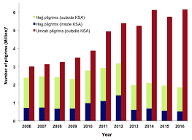
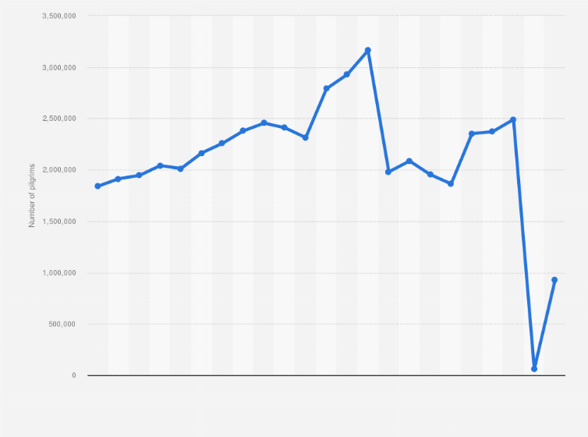
Data Presentation Techniques
Bar Charts:
Purpose: Compare data across categories or show trends over time.
Example: Imagine a bar graph displaying the number of pilgrims from different States who participated in Hajj over the past decade. Each bar represents a country, and its height corresponds to the number of pilgrims from that state.
Line Graph:
Purpose: Display trends and variations over time.
Example: A line graph showing the yearly fluctuations in the total number of Hajj pilgrims. This helps identify patterns and changes.

Slide 43
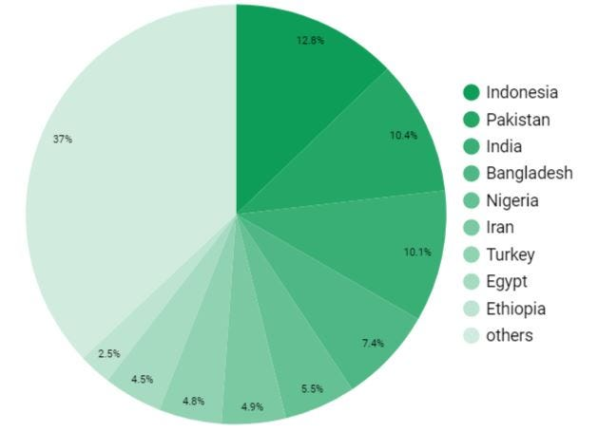
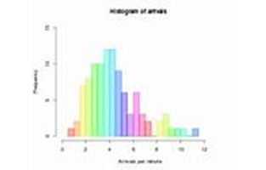
Data Presentation Techniques…..
Pie Chart:
Purpose: Illustrate proportions or percentages.
Example: A pie chart representing the distribution of pilgrims by gender during a specific Hajj season. The slices show the percentage of male and female participants.
Histogram:
Purpose: Visualize frequency distribution of continuous data.
Example: A histogram displaying the age distribution of Hajj pilgrims. It reveals how many fall into different age groups.

Slide 44
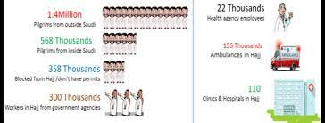
Data Presentation Techniques…..
Pictogram Graph:
Purpose: Use pictorial symbols to visualize a small dataset.
Example: A pictogram representing the services provided to pilgrims, such as accommodation, transportation, and medical assistance.
Textual Presentation:
Purpose: Provide context or summarize findings.
Example: A brief paragraph describing the overall trends in Hajj participation over recent years.

Slide 45
Hajj Statistics
Planning Research and Statistics\Hajj_Statistics_2022_En.xlsx

Slide 46
APPRECIATION
THANK YOU FOR YOUR ATTENTION

