Slide 1
SPEECH WRITING IN THE PUBLIC SERVICE
By Musa Saleh, fwc 08033784074 musasaleh1956@gmail.com

Slide 2
Learning Objective
At the end of the presentation, participants will be bale to:
define speech and speech writing;
discuss Principles of Speech Writing;
discuss guide to speech writing and
discuss structure of a typical speech.

Slide 3
Introduction
Writing a speech for delivery to the public or a group isn’t so much different from other types of writing.
You want to engage audience’s attention to convey ideas in a logical manner.
In addition, the content of the speech and delivery must fit the audience.
Although each speechwriter has a different purpose, what all great writers have in common is clear vision and message.
Since the day of ancient Greece and the teachings of Aristotle, the art of persuasive public speaking has been a powerful and effective form of public communication especially in Governance.

Slide 4
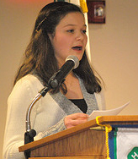
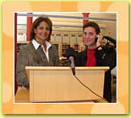
Quotations on Speech-Writing
“Behind every great president, there is a great speechwriter”.
“Every speech is a team effort involving a "long and excruciating" fact-checking process and editing by everyone”.
“Speech is power: speech is to
persuade, to convert, to compel. It is
to bring another out of his bad sense
into your good sense”.

Slide 5
Definition of Speech/Speech-writing
Speech – is a formal address or discourse delivered to an audience. It could be verbal or in writing.
The art of writing usually for delivery by someone else.
In the public service, the principals are not expected to write their speeches by themselves but at least consider drafts prepared by their subordinate
Who is a Speech-writer?
A speechwriter is a person who is hired to prepare and write speeches that will be delivered by another person.
In the public services, they are officers employed and trained to write speeches as situation demands.
Clients of Speech-writers?
Speechwriters are used by many senior-level elected officials and government executives, governors, and the president or prime minister of a country.
Speechwriters are also used in the private sector, to write speeches or presentations for company presidents and Chief Executive Officers.

Slide 6
Speech preparation is the most important element to a successful presentation
It is also the best way to reduce
nervousness and combat fear.

Slide 7
Government Speech Writers
A government speechwriter helps top government functionaries communicate their vision, policies and objectives.
Some are based within the press office, some work from home, many work within the ministerial private office – from where you actually get much better access to the government functionary.
Some are career civil servants who occupy the role for a period of time before moving on.
Some have come from outside the public service, mainly journalism.

Slide 8
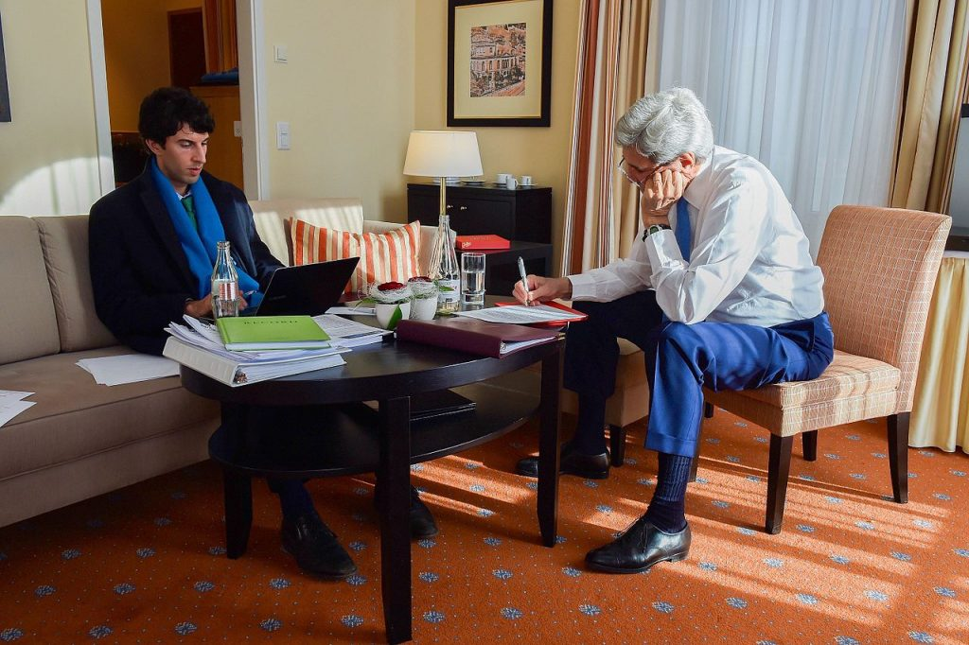
What a Government Speech Writer Does
It often starts with an initial meeting
with the government functionary
to get a broad understanding of the main points they want
to make.
Then, it’s about having detailed conversations with policy teams – often multiple teams, analysts, political special advisers and press officers.
During this process, the speechwriter is the conduit through which the ideas flow. They are the lightning rod, capturing every thought, every angle and every idea offered up.

Slide 9
It is through the speechwriter that those ideas are then distilled, ordered, reordered, refined and woven into a narrative that makes sense and fits together.
To do that, a speechwriter needs to be able to convey complex information simply and compellingly.
They need to bring it all together into a coherent whole that, like a piece of music, ebbs and flows to hold interest and create contrasts – quiet bits and loud bits, long flowing passages and short staccato points, poetry and policy prose.
After the extensive collaboration, this is the part where the speechwriter needs quiet solitude, which can be in short supply in a government department.

Slide 10
Principles of Speech Writing/Steps in writing Speech
Know your core message
Conducting the audience analysis
Determining the purpose
Selection of the topic
Gathering relevant data/Research
Considering the nature of the speech presenter
Good editorial before final speech/Draft
Choose a presentation tool
Practice and revise

Slide 11
A guide to Speech Writing
In order to prepare a good speech, the writer should:
know his/her subject,
be up to date in the area to be covered by the speech.
be familiar with the recent developments in the field by studying widely and cross checking his/her facts.
avoid the use of bogus statistics.

Slide 12
The speech writer or presenter should be well skilled in audience assessment. He/she should
also have an idea of who and how many people he/she is writing for.
you may need to inject some drama, humour and appeal to people’s emotions .
knowledge of the size of the hall, sound effect and lighting conditions could be helpful for a public speaker

Slide 13
Style
Speech writing requires use of active verbs, use simple everyday words and avoidance of jargons and abbreviations.

Slide 14
Basic Types of Speeches
Informative
This speech serves to provide interesting and useful information to your audience.
Some examples of informative speeches:
A teacher telling students about earthquakes;
A student talking about her research;
A travelogue about the Banana Island in Lagos;
A computer programmer speaking about new software.
Mr. President informing the citizens about introduction of subsidy on agricultural machineries

Slide 15
Demonstrative Speeches
A demonstrative speech teaches you something. It has many similarities with an informative speech.
The main difference lies in including a demonstration of how to do the thing you’re teaching.
Some examples of demonstrative speeches:
How to start your own blog;
How to bake a cake;
How to write a speech.
How to fly a helicopter to student pilots
How to open an account in a bank

Slide 16
Persuasive
A persuasive speech works to convince people to change in some way: they think, the way they do something, or to start doing something that they are not currently doing.
Some examples of persuasive speeches:
Become an orphan donor;
Improve your health through better eating;
Television violence is negatively influencing our children;
Become a volunteer and change the world.

Slide 17
Entertaining
The speaker provides pleasure and enjoyment that make the audience laugh or identify with anecdotal information.
The after-dinner speech is a typical example of an entertaining speech.
Some examples of entertaining speeches:
Excuses for any occasion;
Things you wouldn’t know without the movies.

Slide 18
Structure of a Speech
A speech should have four components: the heading, protocol, introduction, body conclusion.
Introduction
The introduction should get the audience's attention, describe the topic, state the purpose, and give an overview of the speech and its main points.
Open with a detailed map of your speech--giving good directions in the beginning will save your audience from getting lost along the way.

Slide 19
Main Points
Thinking of "main points" rather than a "body" can help speakers remember to keep it simple.
A restless audience may not have patience for the predictable, orderly progression of concrete details and commentary that is typical in the body of an academic essay.
Above all, communicate a few important points!

Slide 20
Conclusion
The conclusion should summarize main points and state a strong thesis.
Remember that many people struggle with auditory learning, and consequently have trouble focusing on spoken words.
Your listeners may not put everything together on their own, so you should make it easier for them by summarizing your argument and reviewing central ideas in the conclusion.

Slide 21
How to Write an Effective Speech in the Public Service
Know your audience
Choose your topic
Find your purpose
Make it passionate
Keep your message clear
Evidence
Organizing

Slide 22
SPEECH PRESENTATION 6 ways to present an effective speech
Learn your time limit and calculate your word count
Divide the speech into five parts (five)
Tell stories or give examples
Employ humour — but use it carefully and build it into the subject of your speech
Read the speech aloud
Be yourself

Slide 23
I like the sound of this! How do I become a speechwriter?
No formal qualifications are required.
A flair for writing, an interest in politics and public affairs are important, as is emotional intelligence and the ability to completely absorb the language and tone of another person.
Resilience and a thick skin are also needed to withstand the never-ending deadlines and pressure that are brought to bear on a speechwriter.
In terms of training, there are some excellent short courses out there for aspiring speechwriters.

Slide 24
Conclusion
The true art of speechwriter is to impart key messages and convey complexities in a succinct manner.
Remember that you're writing a speech, not an essay. People will hear the speech, not read it. The more conversational you can make it sound, the better!
Speechwriting is a job of contradictions, but that’s what makes it one of the most interesting, challenging and rewarding jobs in the Public service.
In the 21st century, speech will continue to play an important role in government communication.

